Slide 1
STRINGS STRUCTURES & UNION

Slide 2

What are Strings
As group of integers can be stored as integer array, similarly, group of characters can be group as character array.
Character arrays are also called STRINGS. Strings are used by many programmling languages to manipulate words and sentences.
A string constant is a one dimensional-array of characters terminated by a null (‘\0’), like:
char name[ ]={‘H’, ‘A’, ‘E’, ‘S’, ‘L’, ‘E’, ‘R’, ‘\0’};
Each character in the array occupies one byte of memory and the last character is always ‘\0’ which is the null character.

Slide 3
%s String Format Specification
The %s used in printf( ) is a format specification for printing out a string. The same specification can be used to receive a string from the keyboard.
void main( )
{
char name[ ] = "Klinsman" ;
printf ( "%s", name ) ;
}

Slide 4
String as character array
/* Program to demonstrate printing of a string */
#include<stdio.h>
void main( )
{
char name[ ] = "Klinsman" ;
int i = 0 ;
while ( i <= 7 )
{
printf ( "%c", name[i] ) ;
i++ ;
}
}

Slide 5
String example
#include <stdio.h>
void main( )
{
char name[25] ;
printf ( "Enter your name: " ) ;
scanf ( "%s", name ) ;
printf ( "Hello %s!", name ) ;
}

Slide 6
Caution on Using scanf() on String
The length of the string should not exceed the dimension of the character array. This is because the C compiler doesn’t perform bounds checking on character arrays.
scanf( ) is not capable of receiving multi-word strings. Therefore names such as ‘Debashish Roy’ would be unacceptable. The way to get around this limitation is by using the function gets( ). The usage of functions gets( ) and its counterpart puts( )

Slide 7
puts ( ) and gets () example
#include <stdio.h>
void main( )
{
char name[25] ;
printf ( "Enter your fullname: " ) ;
gets ( name ) ;
puts ( "Hello!" ) ;
puts ( name ) ;
}

Slide 8
Pointers and Strings
We can either store it in a string or we may ask the C compiler to store it at some location in memory and assign the address of the string in a char pointer
char str[ ] = "Hello" ;
char *p = "Hello" ;
We cannot assign a string to another, whereas, we can assign a char pointer to another char pointer.
Once a string has been defined it cannot be initialized to another set of characters. Unlike strings, such an operation is perfectly valid with char pointers.

Slide 9
Pointers and strings
#include <stdio.h>
void main( )
{
char str1[ ] = "Hello" ;
char *p = "Hello" ;
//str1 = "Bye" ; /* error */
p = "Bye" ; /* works */
printf("%s\n",str1);
printf("%s",p);
}

Slide 10
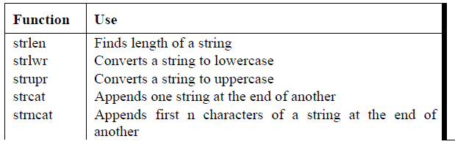
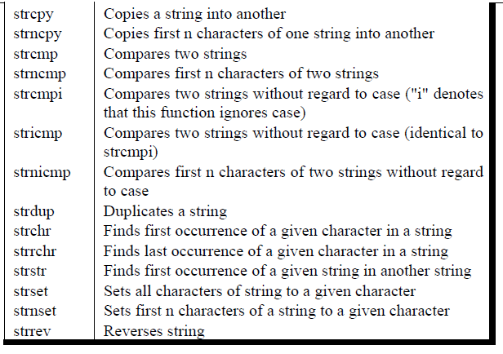
Standard Library String Functions
With every C compiler a large set of useful string handling library functions are provided.

Slide 11
strlen( )
This function counts the number of characters present in a string.
Note that in the first call to the function strlen( ), we are passing the base address of the string, and the function in turn returns the length of the string. While calculating the length it doesn’t count ‘\0’.

Slide 12
strlen ( ) example
#include <stdio.h>
void main( )
{
char arr[ ] = "Bamboozled" ;
int len1, len2 ;
len1 = strlen ( arr ) ;
len2 = strlen ( "Humpty Dumpty" ) ;
printf ( "\nstring = %s length = %d", arr, len1 ) ;
printf ( "\nstring = %s length = %d", "Humpty Dumpty", len2 ) ;
}

Slide 13
strcpy( )
This function copies the contents of one string into another. The base addresses of the source and target strings should be supplied to this function.
On supplying the base addresses, strcpy( ) goes on copying the characters in source string into the target string till it doesn't encounter the end of source string (‘\0’). It is our responsibility to see to it that the target string’s dimension is big enough to hold the string being copied into it.

Slide 14
strycpy ( ) example
#include <stdio.h>
void main( )
{
char source[ ] = "Sayonara" ;
char target[20] ;
strcpy ( target, source ) ;
printf ( "\nsource string = %s", source ) ;
printf ( "\ntarget string = %s", target ) ;
}

Slide 15
strcat( )
This function concatenates the source string at the end of the target string.
Note that the target string has been made big enough to hold the final string.

Slide 16
strcat ( ) example
#include <stdio.h>
main( )
{
char source[ ] = "Folks!" ;
char target[30] = "Hello" ;
strcat ( target, source ) ;
printf ( "\nsource string = %s", source ) ;
printf ( "\ntarget string = %s", target ) ;
}

Slide 17
strcmp( )
This is a function which compares two strings to find out whether they are same or different. The two strings are compared character by character until there is a mismatch or end of one of the strings is reached, whichever occurs first.
If the two strings are identical, strcmp( ) returns a value zero. If they’re not, it returns the numeric difference between the ASCII values of the first non-matching pairs of characters.

Slide 18
strcmp ( ) example
#include <stdio.h>
void main( )
{
char string1[ ] = "Jerry" ;
char string2[ ] = "Ferry" ;
int i, j, k ;
i = strcmp ( string1, "Jerry" ) ;
j = strcmp ( string1, string2 ) ;
k = strcmp ( string1, "Jerry boy" ) ;
printf ( "\n%d %d %d", i, j, k ) ;
}

Slide 19
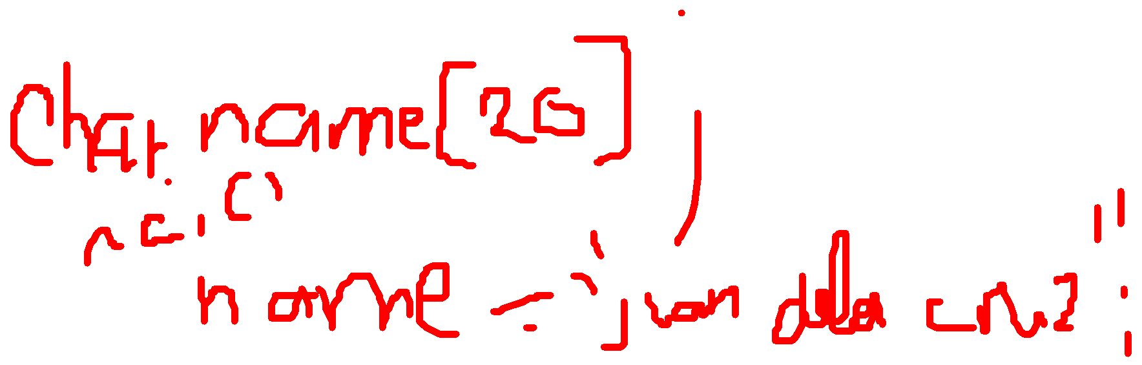
Data Types Revisited
C programming language which has the ability to divide the data into different types. The type of a variable determine the what kind of values it may take on. The various data types are
Simple Data type
🡪 Integer, Float, Void, Char
Structured Data type
🡪Array, Strings
User Defined Data type
🡪Enum, Structures, Unions

Slide 20
Structure Data Type
A structure is a user defined data type that groups logically related data items of different data types into a single unit. All the elements of a structure are stored at contiguous memory locations.
A variable of structure type can store multiple data items of different data types under the one name.
For example, as the data of employee in company that is name, Employee ID, salary, address, phone number is stored in structure data type.

Slide 21
Defining of Structure
A structure has to defined, before it can used. The syntax of defining a structure is
struct <struct_name>
{
<data_type> <variable_name>;
<data_type> <variable_name>;
……..
<data_type> <variable_name>;
};

Slide 22
Structure example
The structure of Employee is declared as
struct employee
{
int emp_id;
char name[20];
float salary;
char address[50];
int dept_no;
int age;
};

Slide 23
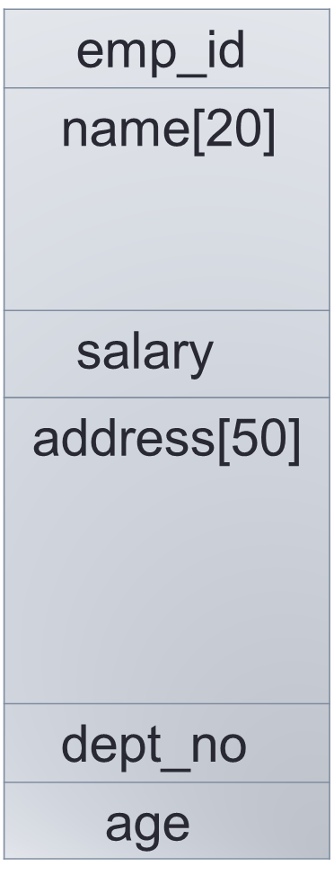
Memory Space Allocation
8000
8002
8022
8024
8074
8076
8078 employee
Notes:
‹#›

Slide 24
Declaring a Structure Variable
A structure has to declared, after the body of structure has defined. The syntax of declaring a structure is
struct <struct_name> <variable_name>;
The example to declare the variable for defined structure “employee”
struct employee e1;
Here e1 variable contains 6 members that are defined in structure.
structpptsamp.c

Slide 25
Initializing a Structure Members
The members of individual structure variable is initialize one by one or in a single statement. The example to initialize a structure variable is
struct employee e1 = {1, “Hemant”,12000, “3 vikas colony new delhi”,10, 35);
e1.emp_id=1; e1.dept_no=1 e1.name=“Hemant”; e1.age=35;
e1.salary=12000;
e1.address=“3 vikas colony new delhi”;
structsamp1.c

Slide 26
Accessing a Structure Members
The structure members cannot be directly accessed in the expression. They are accessed by using the name of structure variable followed by a dot and then the name of member variable. The method used to access the structure variables are e1.emp_id, e1.name, e1.salary, e1.address, e1.dept_no, e1.age. The data with in the structure is stored and printed by this method using scanf and printf statement in c program.

Slide 27
Structure Assignment
The value of one structure variable is assigned to another variable of same type using assignment statement. If the e1 and e2 are structure variables of type employee then the statement:
e1 = e2;
It assigns the value of structure variable e2 to e1. The value of each member of e2 is assigned to corresponding members of e1.

Slide 28
struct example 1
#include <stdio.h>
struct student
{
char initial; /* last name initial */
int age; /* childs age */
int grade; /* childs grade in school */
} s1,s2;
int main()
{
struct student s3 = {'G',15, 90 };
s1.initial = 'R';
s1.age = 15;
s1.grade = 75;
s2.age = s1.age - 1; /* she is one year younger */
s2.grade = 82;
s2.initial = 'H';
printf("%c is %d years old and got a grade of %d\n",
s2.initial,s2.age,s2.grade);
printf("%c is %d years old and got a grade of %d\n",
s1.initial, s1.age, s1.grade);
printf("%c is %d years old and got a grade of %d\n",
s3.initial, s3.age, s3.grade);
return 0;
}

Slide 29
Array of Structure
C language allows to create an array of variables of structure. The array of structure is used to store the large number of similar records. For example to store the record of 5 employees then array of structure is used. The method to define and access the array element of array of structure is similar to other array. The syntax to define the array of structure is
struct <struct_name> <array_name> [<value>];
For Example:
struct employee e1[5];

Slide 30
Struct with arrays example
#include <stdio.h>
struct student{
char name[50];
int roll;
float marks;
};
int main(){
struct student s[10];
int i;
printf("Enter information of students:\n");
for(i=0;i<10;++i)
{
s[i].roll=i+1;
printf("\nFor roll number %d\n",s[i].roll);
printf("Enter name: ");
scanf("%s",s[i].name);
printf("Enter marks: ");
scanf("%f",&s[i].marks);
printf("\n");
}
printf("Displaying information of students:\n\n");
for(i=0;i<10;++i)
{
printf("\nInformation for roll number %d:\n",i+1);
printf("Name: ");
puts(s[i].name);
printf("Marks: %.1f",s[i].marks);
}
return 0;
}

Slide 31
Structures within Structures
C language define a variable of structure type as a member of other structure type. The syntax to define the structure within structure is struct <struct_name>{
<data_type> <variable_name>;
struct <struct_name>
{ <data_type> <variable_name>;
……..}<struct_variable>;
<data_type> <variable_name>;
};

Slide 32
Structures within structures example
#include <stdio.h>
#include <string.h>
struct student_college_detail
{
int college_id;
char college_name[50];
};
struct student_detail
{
int id;
char name[20];
float percentage;
// structure within structure
struct student_college_detail clg_data;
}stu_data;
int main()
{
struct student_detail stu_data = {1, "Raju", 90.5, 71145,
"Anna University"};
printf(" Id is: %d \n", stu_data.id);
printf(" Name is: %s \n", stu_data.name);
printf(" Percentage is: %f \n\n", stu_data.percentage);
printf(" College Id is: %d \n",
stu_data.clg_data.college_id);
printf(" College Name is: %s \n",
stu_data.clg_data.college_name);
return 0;
}

Slide 33
Pointers and Structures
C language can define a pointer variable of structure type. The pointer variable to structure variable is declared by using same syntax to define a pointer variable of data type. The syntax to define the pointer to structure
struct <struct_name> *<pointer_var_name>;
For Example:
struct employee *emp;
It declare a pointer variable “emp” of employee type.

Slide 34
Access the Pointer in Structures
The member of structure variable is accessed by using the pointer variable with arrow operator(🡪) instead of period operator(.). The syntax to access the pointer to structure.
pointer_var_name🡪structure_member;
For Example:
emp🡪name;
Here “name” structure member is accessed through pointer variable emp.

Slide 35
Structure with pointers
#include <stdio.h>
struct Book {
char name[20];
int price;
};
int main() {
struct Book b;
struct Book* ptr;
ptr = &b;
ptr->name ="D";
ptr->price ="800";
printf("Book name %s", ptr->name);
printf("Book price %d", ptr->price);
}

Slide 36
Passing Structure to Function
The structure variable can be passed to a function as a parameter. The program to pass a structure variable to a function.

Slide 37
Passing struct to function
#include <stdio.h>
struct employee
{
int emp_id;
char name[20];
float salary;
};
//void printdata( struct employee emp);
void main ( )
{
struct employee e1;
printf ("Enter the employee id of employee");
scanf("%d",&e1.emp_id);
printf ("Enter the name of employee");
scanf("%s",e1.name);
printf ("Enter the salary of employee");
scanf("%f",&e1.salary);
printdata(struct employee e1);
}
void printdata(struct employee emp)
{
printf ("\nThe employee id of employee is : %d", emp.emp_id);
printf ("\nThe name of employee is : %s", emp.name);
printf ("\nThe salary of employee is : %f", emp.salary);
}

Slide 38
Union Data Type
A union is a user defined data type like structure. The union groups logically related variables into a single unit.
The union data type allocate the space equal to space need to hold the largest data member of union. The union allows different types of variable to share same space in memory.
There is no other difference between structure and union than internal difference. The method to declare, use and access the union is same as structure.
Notes:
‹#›

Slide 39
Defining of Union
A union has to defined, before it can used. The syntax of defining a structure is
union <union_name>
{
<data_type> <variable_name>;
<data_type> <variable_name>;
……..
<data_type> <variable_name>;
};
Notes:
‹#›

Slide 40
Union example
#include <stdio.h>
#include <string.h>
union Data
{
int i;
float f;
char str[20];
};
int main( )
{
union Data data;
data.i = 10;
printf( "data.i : %d\n", data.i);
data.f = 220.5;
printf( "data.f : %1f\n", data.f);
strcpy( data.str, "C Programming");
printf( "data.str : %s\n", data.str);
return 0;
}

Slide 41
Memory Space Allocation
8000
emp_id, dept_no, age
8002
salary
8004
name
8022
address
8050
employee
Notes:
‹#›

Slide 42
Difference between Structures & Union
The memory occupied by structure variable is the sum of sizes of all the members but memory occupied by union variable is equal to space hold by the largest data member of a union.
In the structure all the members are accessed at any point of time but in union only one of union member can be accessed at any given time.
Notes:
‹#›

Slide 43
Assignment:
Directions: Compressed the two programs in a zip file with the filename: assign5<yourname>. You may send it through email (jethrogamad@gmail.com) or give it to me next meeting.
Write a program that converts all lowercase characters in a given string to its equivalent uppercase character. Save as stringassign.c
A record contains name of cricketer, his age, number of test matches that he has played and the average runs that he has scored in each test match. Create an array of structure to hold records of 10 such cricketer. Save as structassign.c

